Slide 2
Virtual Open Event
For Admissions September 2021

Slide 3
A tour

Slide 4
Our story so far…
APSoL opened September 2020 after a 5-year dream, with a 1-form (30 children) Reception cohort, intending to grow year-on-year.
APSoL is located on the west wing of South Thames College and is a separate site to the college.
From September 2021, APSoL Reception intake will be 2-form entry (60 children) and will follow PAN London admissions.

Slide 5
Our vision for APSoL
Offer a broad and balanced curriculum
Pupils being able to communicate in two languages
Having high expectations from staff, pupils & parents
Being another high-quality school choice in Wandsworth

Slide 6
APSoL Building
We are now in the process of completing phase 1 works (Reception permanent classrooms)
Phase 2 works, including play decks will commence in 2021
For health and safety reasons, the children will be kept well away from any building works taking place.

Slide 7
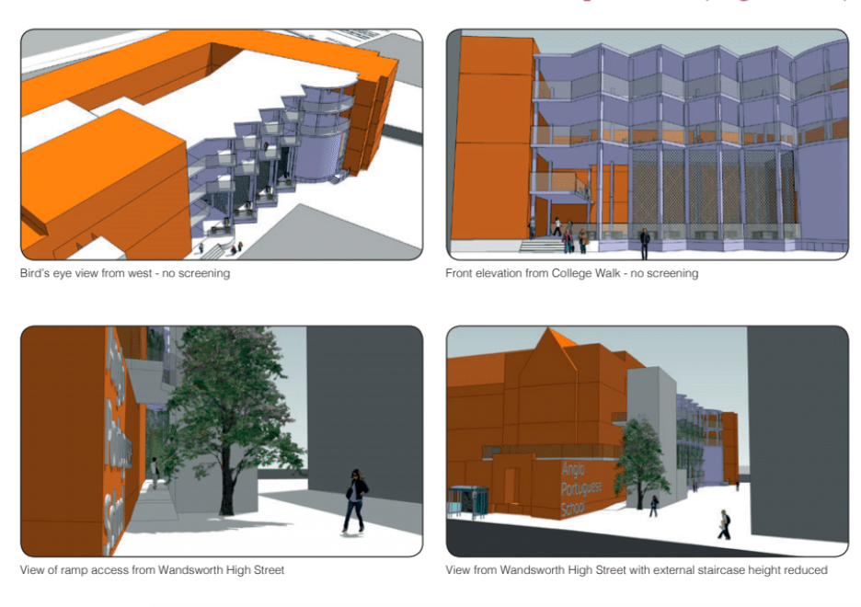
What our school will look like when the works are completed

Slide 8
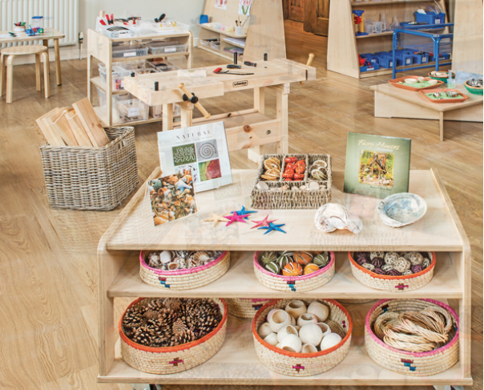
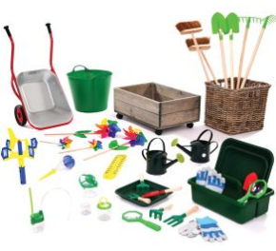
Reception learning environment
Early years framework
Curriculum driven by the children
7 areas of learning (prime and specific)
Highly engaging learning environments
Indoor and outdoor provision
Continuous provision

Slide 9
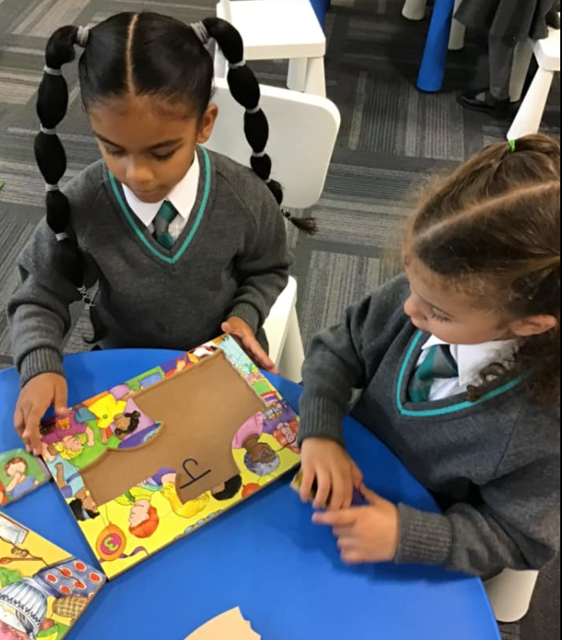
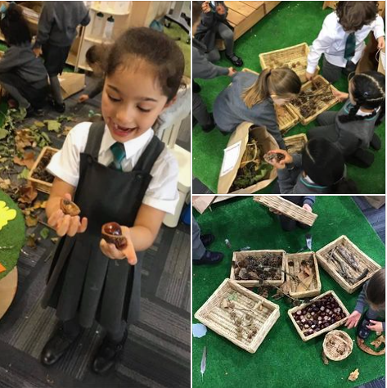
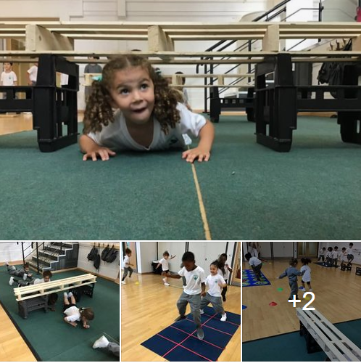
Reception Indoors Environment
Children have access to a wide range of learning opportunities across all areas of learning.
Hall

Slide 10
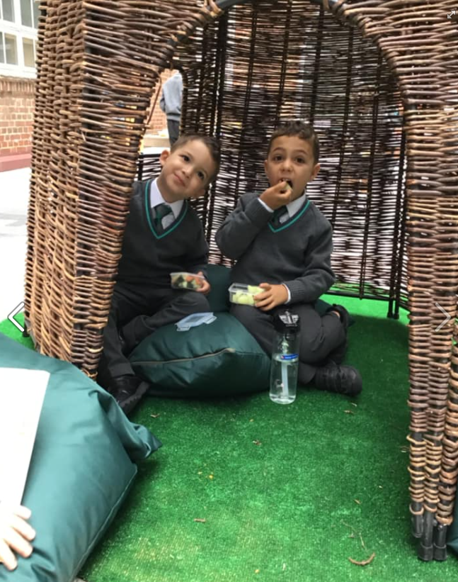
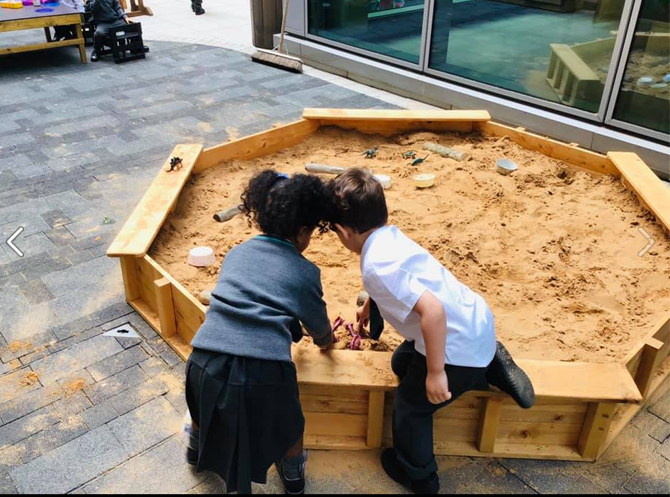
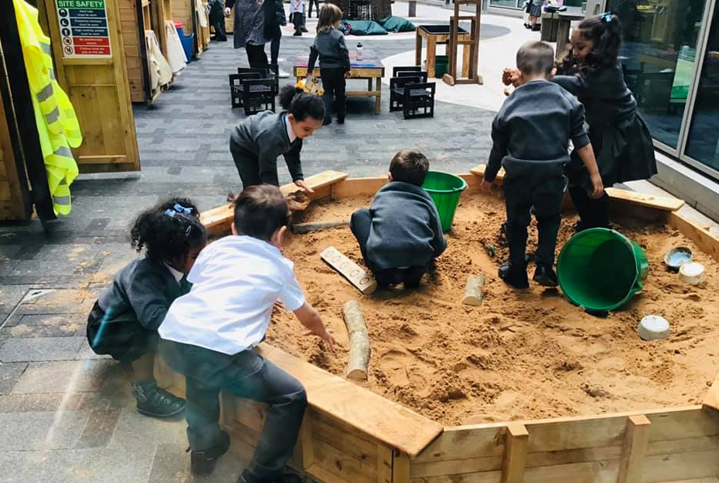
Reception Outdoors Environment
Children have access to a wide range of learning opportunities outdoors throughout the year.

Slide 11
Curriculum at APSoL
British National Curriculum (NC) & Orientações escolares
Curriculum for each subject is linked by creative cross curricular topics. (examples adjacent)
English – high quality
text-led topics
Maths – Maths mastery approach & CPA – Whiterose
Phonics (Reception & KS1)
Portuguese – immersion model in Reception, structured programme for language lessons and CLIL

Slide 12
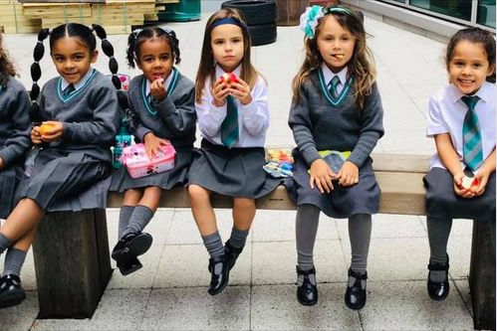
Reception Brochure
Click on the link below to see how we learn in Reception
https://angloportugueseschool.org/wp-content/uploads/2020/04/APSoL-EYFS-Brochure-2020.pdf

Slide 13
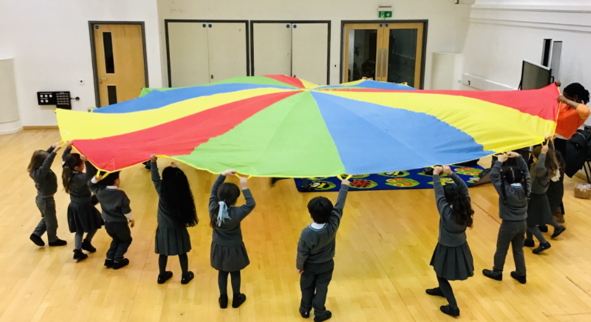
Reception Curriculum at APSoL
https://angloportugueseschool.org/wp-content/uploads/2020/07/APSoL-Curriculum-Overview-Reception.pdf

Slide 14
Why Bilingual Education?
Increased cognitive development
Better academic achievement
Improved memory
Cross cultural appreciation
Enhanced abilities to compete in a global marketplace
http://www.bilingualism-matters.ppls.ed.ac.uk
Bilingual education at APSoL: https://angloportugueseschool.org/en/bilingualism-for-everyone/

Slide 15
Admissions September 2021
60 Reception Year places
Admissions Policy: Nodal points admissions policy (30 places Wandsworth Council, 30 places out of borough)
https://angloportugueseschool.org/wp-content/uploads/2020/07/APsoL-Admissions-Policy-2021.pdf
Pan London e-admissions process. All parents must complete an e-admissions form via their local authority:
https://www.eadmissions.org.uk/
If you have any questions, please contact us: 020 3417 0905

